Slide 1
CLUSTERING

Slide 2
KMEANS CLUSTERING
Algorithm
Metrics ( Elucidian / Manhatan)
Elbow method for selecting K Value

Slide 3
KMEANS CLUSTERING
2,5
(2,3)
(2,3)

Slide 4
KMEANS CLUSTERING

Slide 5
KMEANS CLUSTERING
Mean of First
group
Mean2

Slide 6
KMEANS CLUSTERING
Steps
K value - K is two centroids
Initialize the centroids randomly
Sum the group and find mean

Slide 7
K – USING ELBOW METHOD
50
40
30
20
10
1 2 3 4 5 6

Slide 8
K VALUE
n 2
Within Cluster Sum of Square = E (ci+xi)
i

Slide 9
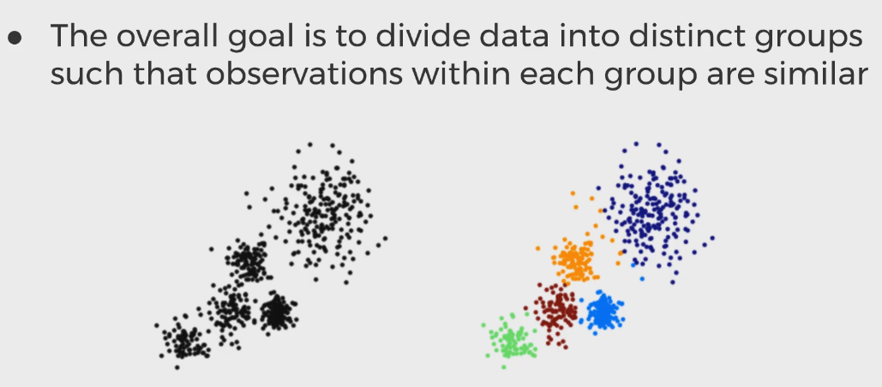
Clustering

Slide 10
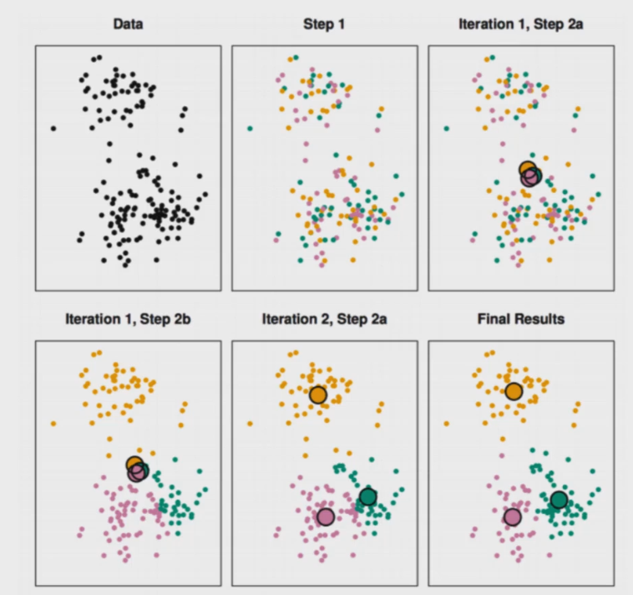
Clustering

Slide 11
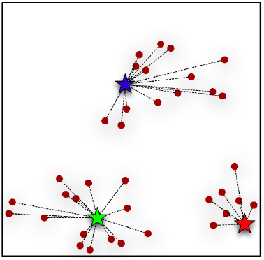
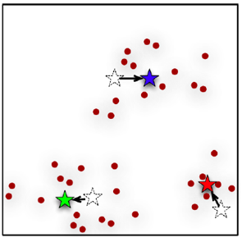
Clustering
It attempts to group individuals in a population together by similarity
centroid based clustering algorithm — K-means

Slide 12
K Means
To run a k-means algorithm,
you have to randomly initialize three points called the cluster centroids
I have three cluster centroids, because I want to group my data into three clusters.
K-means is an iterative algorithm and it does two steps:
1. Cluster assignment step 2. Move centroid step.

Slide 13
Cluster Assignment
In Cluster assignment step, the algorithm goes through each of the data points and depending on which cluster is closer
whether the red cluster centroid or the
blue cluster centroid or the green;
It assigns the data points to one of the
three cluster centroids.

Slide 14
Centroid Movement
Centroid step,
K-means moves the centroids to the average of the points in a cluster
the algorithm calculates the average of all the points in a cluster and moves the centroid to that average location
This process is repeated until there is no change in the clusters
K is chosen randomly or by giving specific initial starting points by the user.

Slide 15
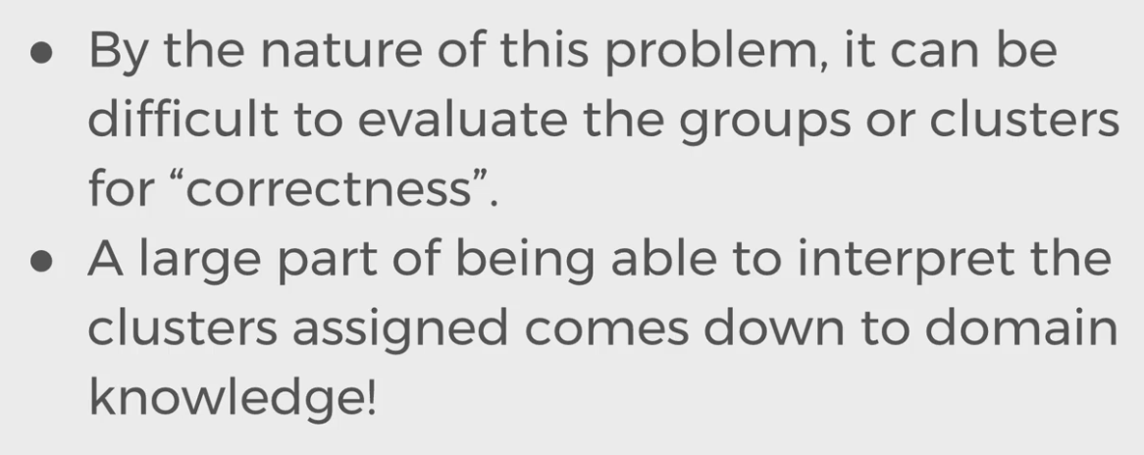
How to determine K?

Slide 16
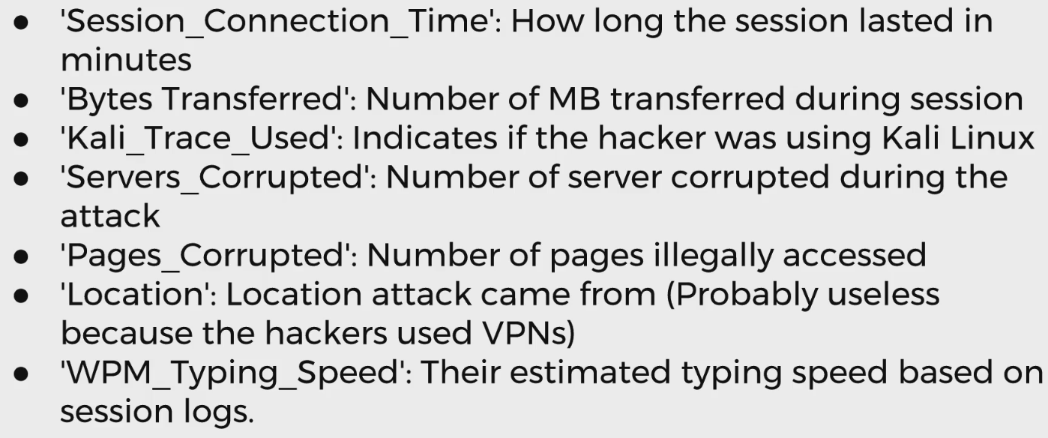
Consulting Project

Slide 17
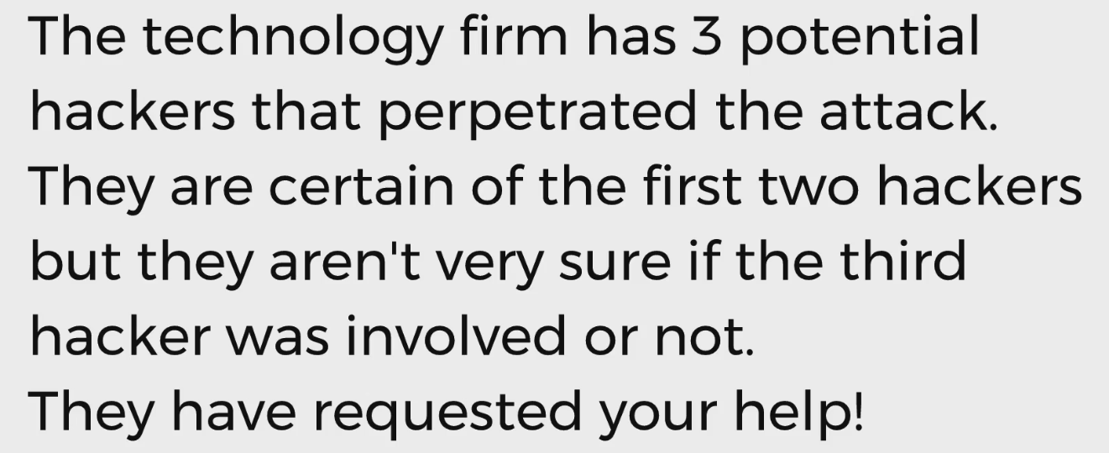

Slide 18
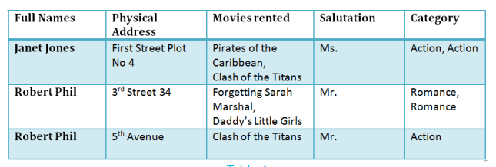
Normalization - Scaler

Slide 19
Normalization
It divides larger tables to smaller tables and links them using relationships.

Slide 20
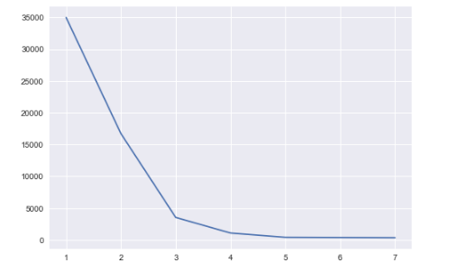
Elbow Method

Slide 21
Other Methods
Average silhouette method
Gap statistic method

